Slide 1

Groep 2b e-health Nick Cuypers Koen Schauwaert Ukko-Pekka Peura Emilia Ryhänen
= F I N A L P R E S E N T A T I O N =

Slide 2
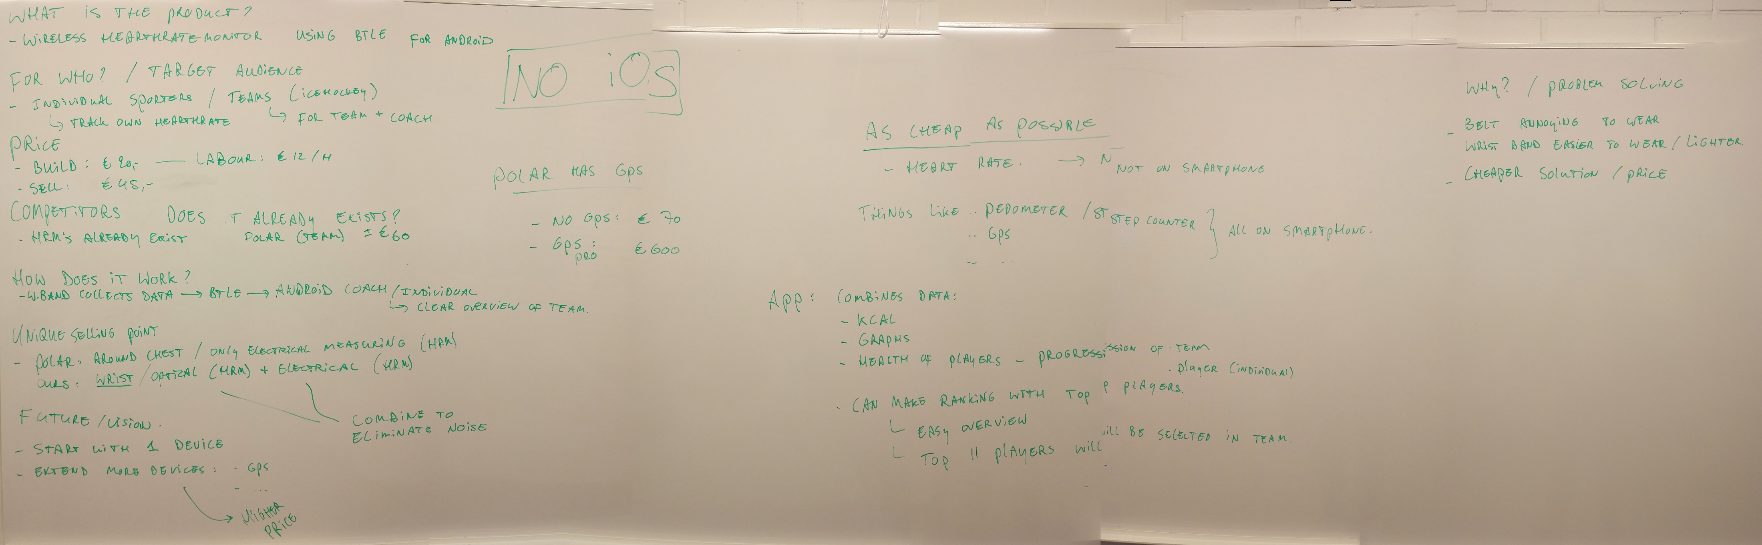

In the beginning there was finland

Slide 3

productname
Fitness
Activitytracker
Social
Team
Solo
Young and hip

Slide 4

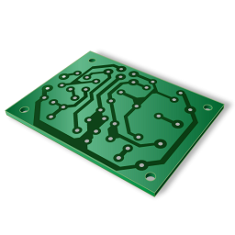

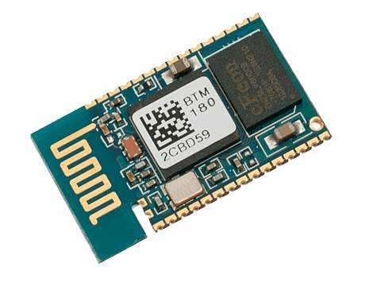

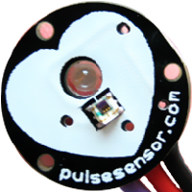
Hardware & software
PCB
LED
2x Android Application
Heart (light) Pulse Sensor
Firebase Database
BT Module
BlueTooth Low Energy

Slide 5
hardware

Slide 6
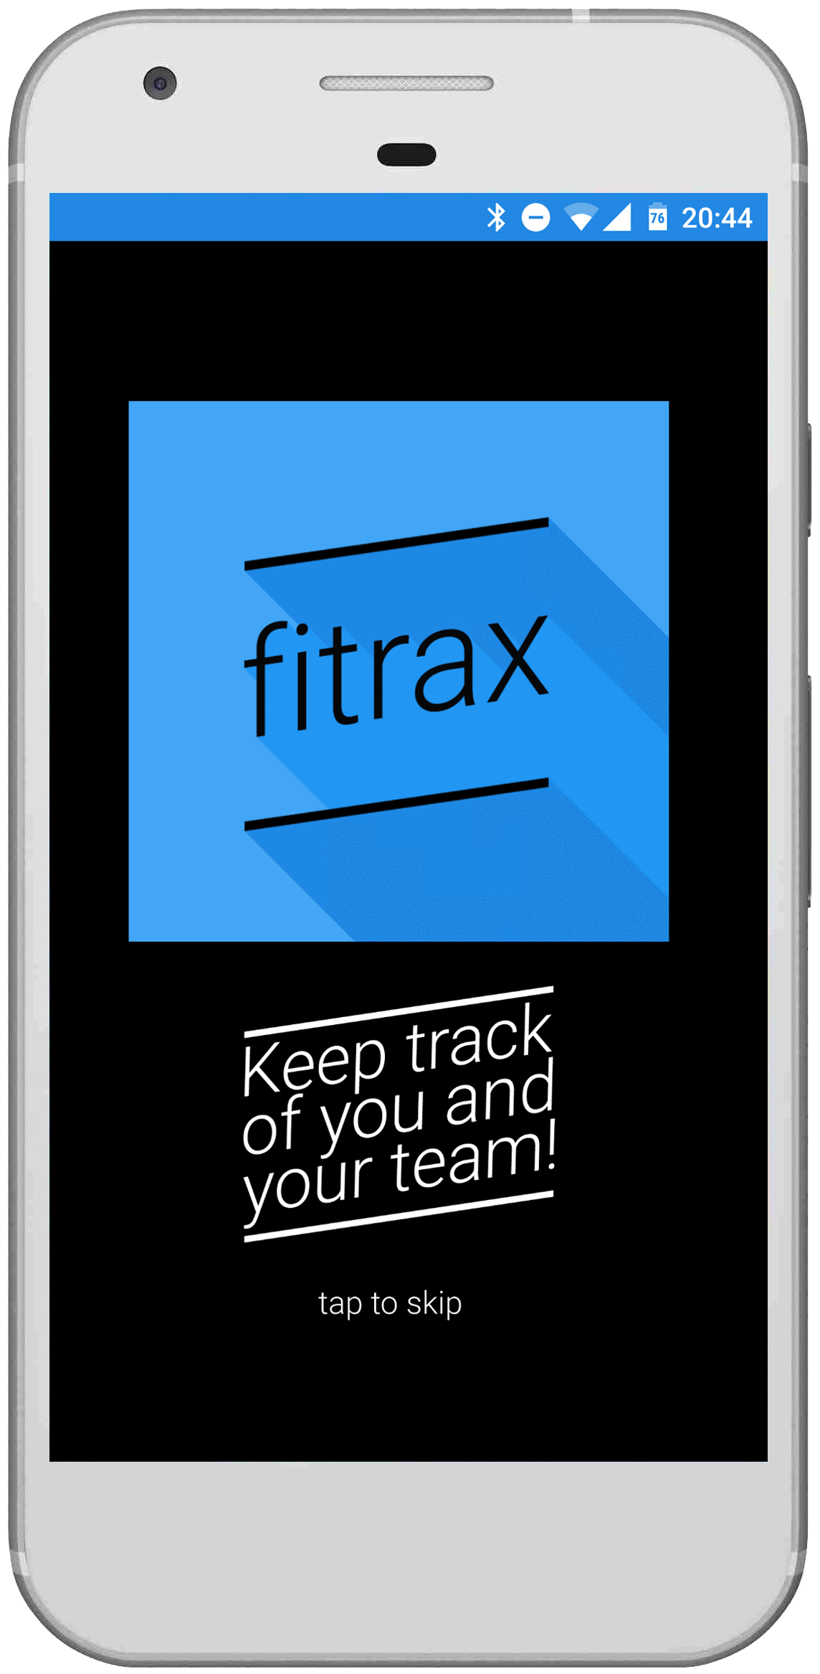
Fitness tracker itself
Printed Circuit Board (PCB)
Green LED: makes bloodflow visible
Pulse (light) Sensor: measures bloodflow (pulse)
BlueTooth Low Energy module
3V battery
Works best directly on finger

Slide 7
software

Slide 8

Logo fitrax
Adobe Photoshop
Material Design

Slide 9

Splash screen
Splash Screen with heartbeat logo
“Tap to skip”
Continues to Login Activity

Slide 10
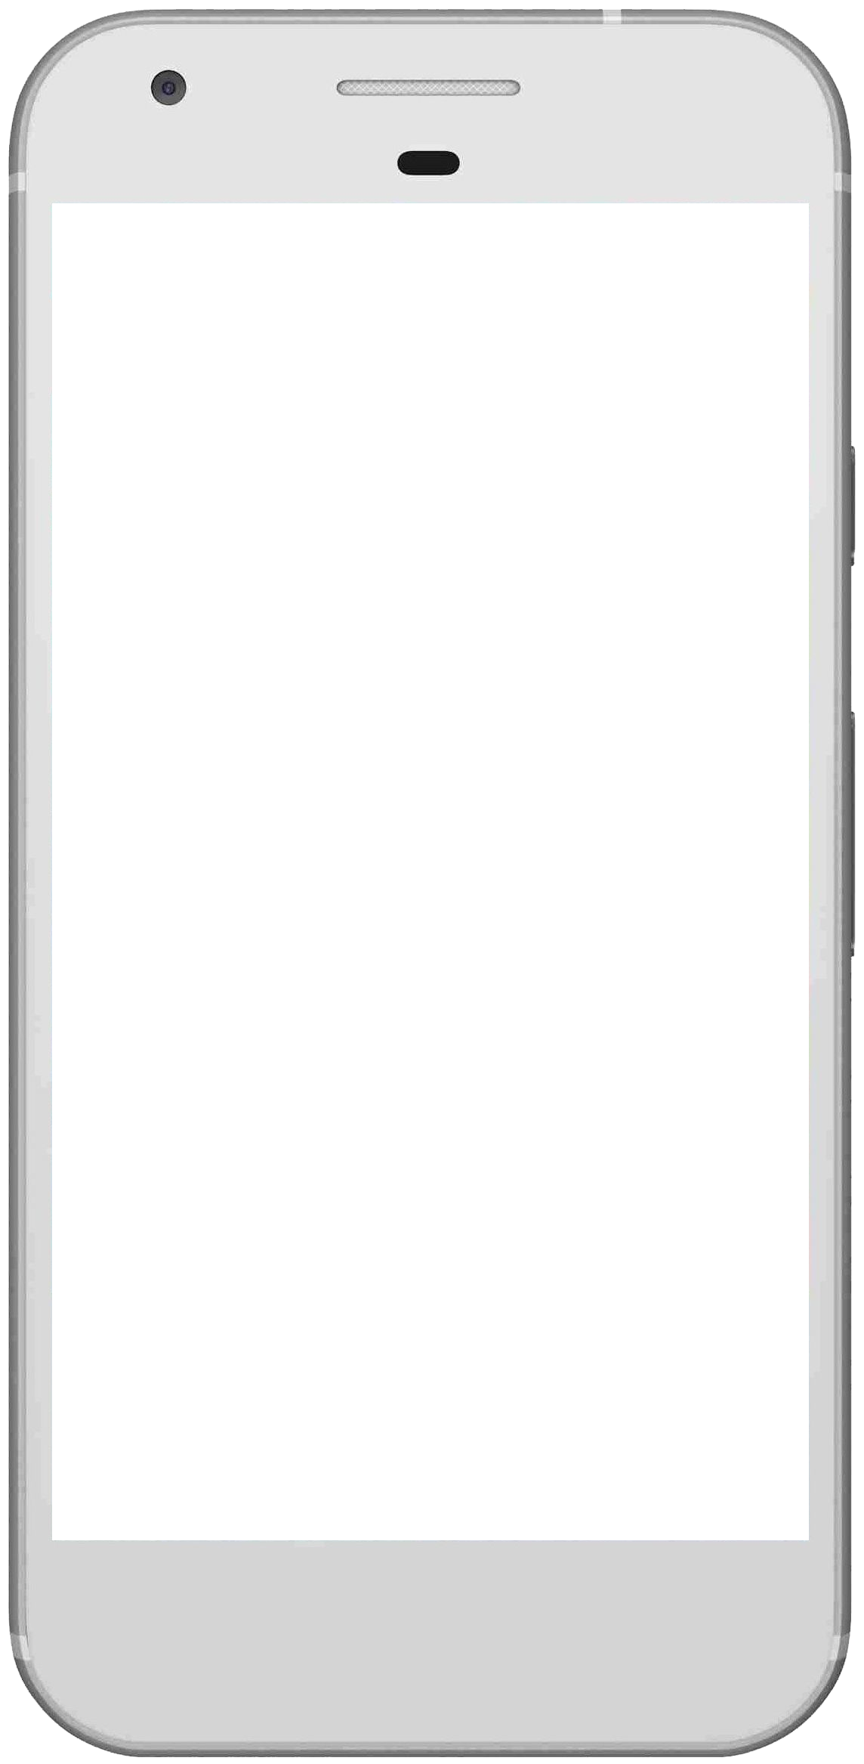
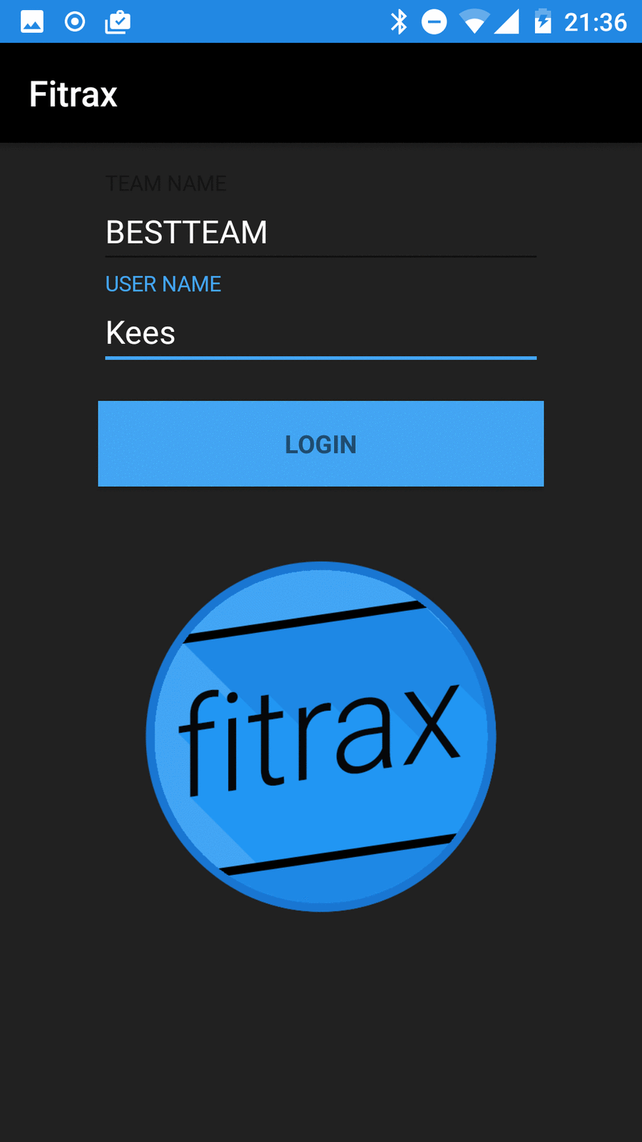
Login activity
Login Activity:
Online login/register
Data goes to Firebase database
Continues to Main Activity

Slide 11
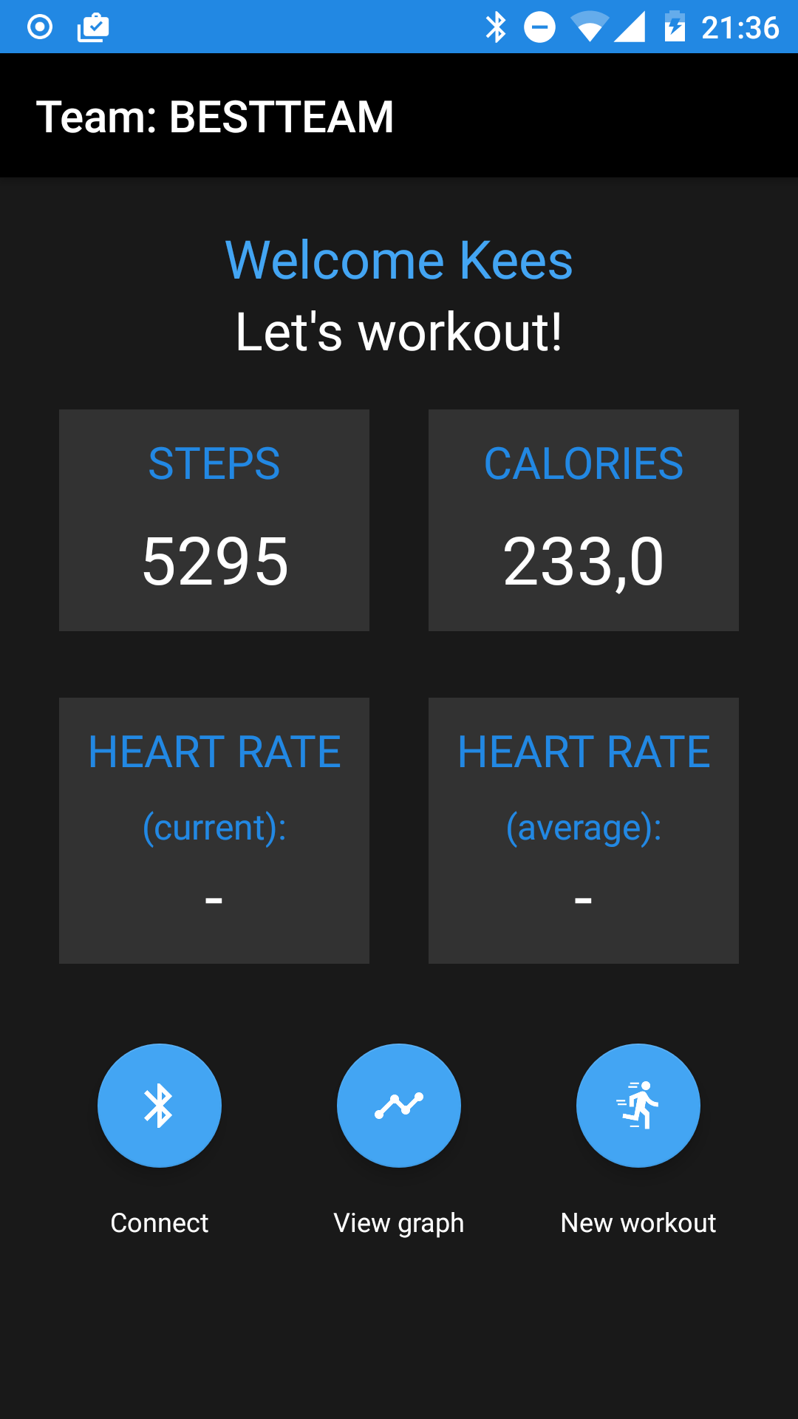
Main activity
Team name at top
User name + random welcome message
4 “blocks”:
Steps taken
Calories burned
Heart rate (current)
Heart rate (average)
3 buttons:
Connect
View graph
New workout

Slide 12
Steps taken
Google Fit API:
Sensor.TYPE_STEP_COUNTER
Data used to calculate burned calories
Sends data to database

Slide 13
Calories burned
Formula complex:
Weight user and time taken over 100 m
Our focus not on stepcounter
Average person:
0,044 KCAL each step
double caloriesBurned = steps * 0.044

Slide 14
Heart rate (current)
Gets data from BlueTooth device
Updates field at every new data
Directly pushes data to database

Slide 15
Heart rate (average)
Uses current heart rate to calculate average
Stores data directly in database

Slide 16
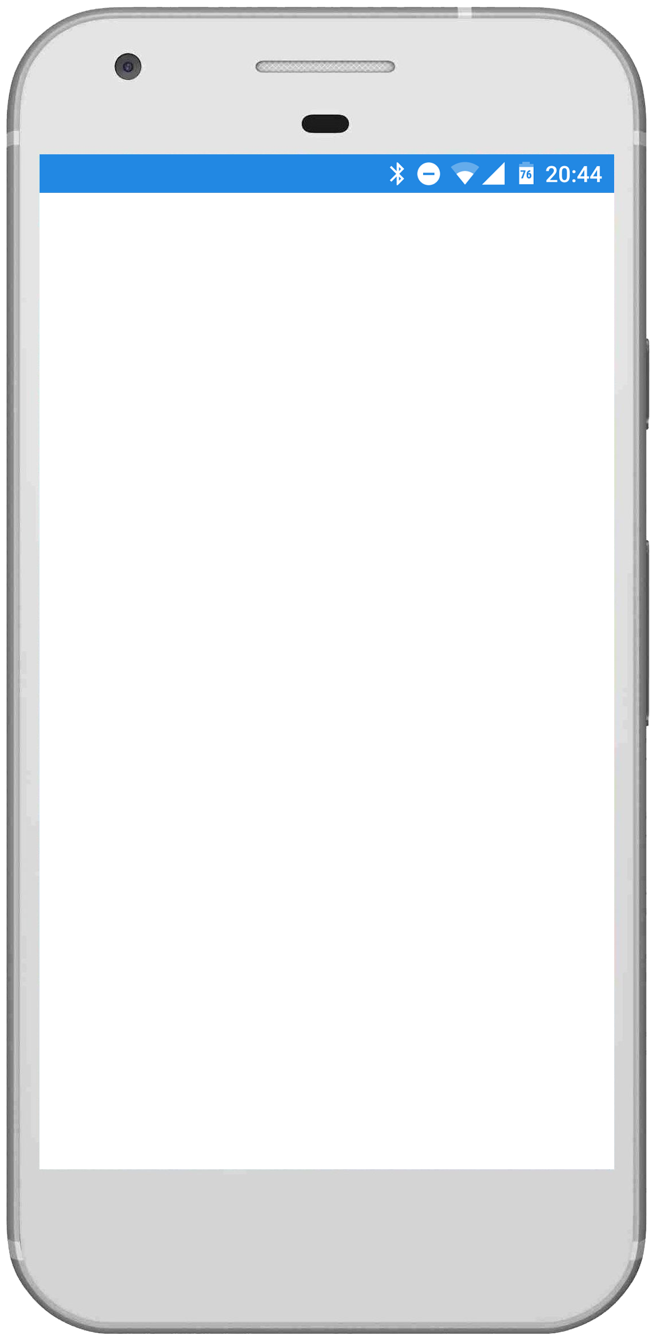
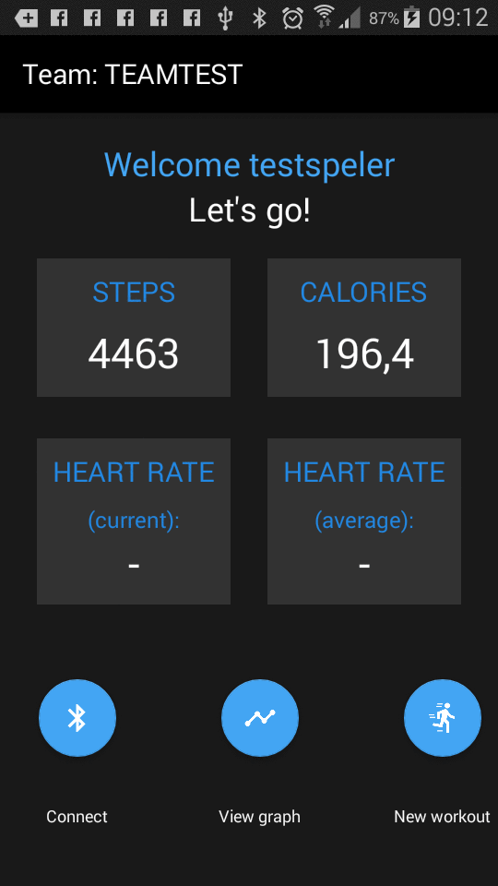
Connect
To connect to BlueTooth Low Energy device
Opens dialog
Directly updates data

Slide 17
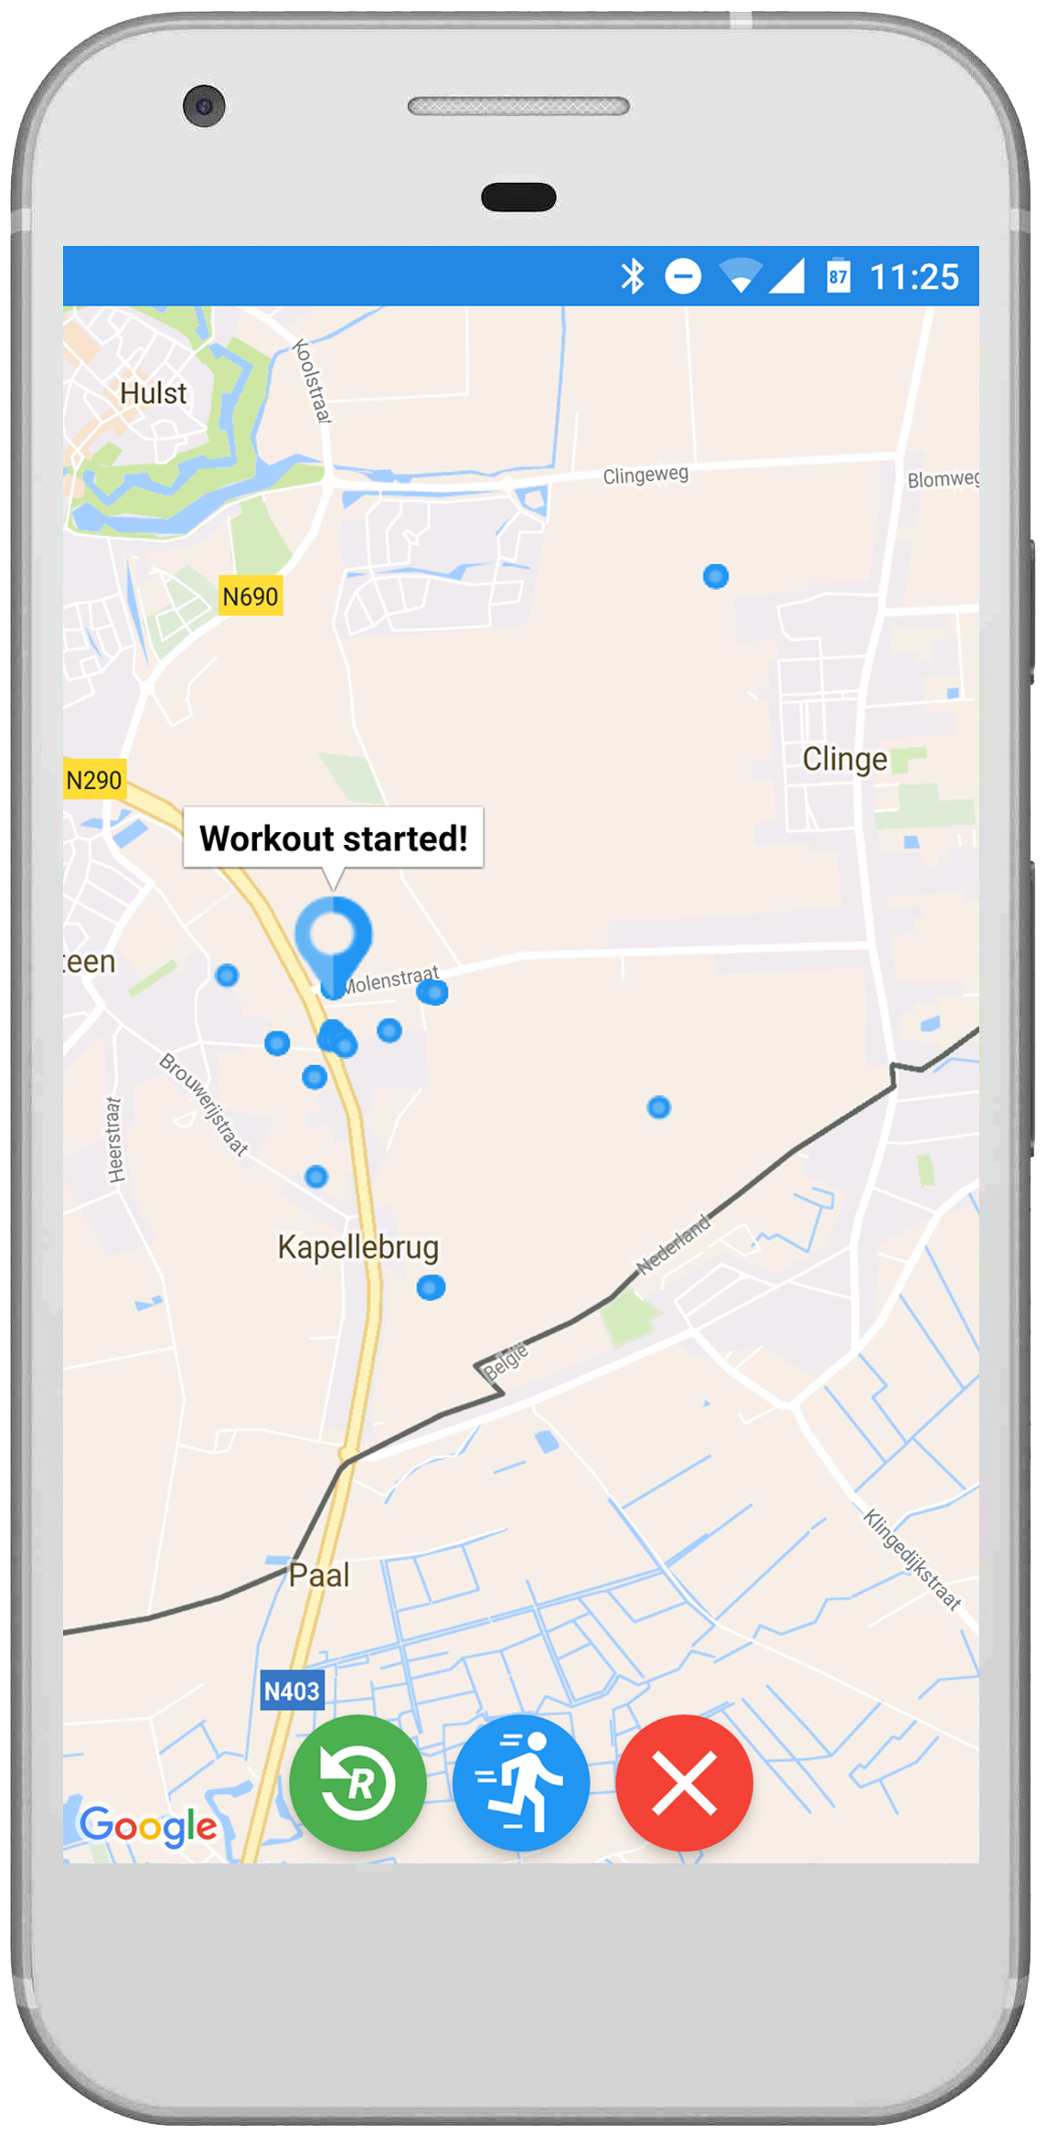
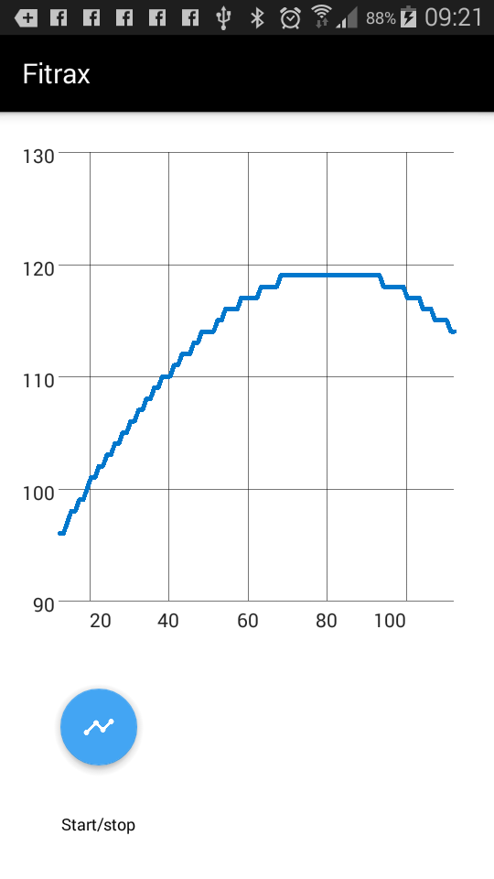
View graph
Shows graph with current heart rate data
Scrollable
Simple start/stop button to control livefeed

Slide 18
New workout
Starts Map Activity
Saves location every 5 seconds in List
Draws location on map
Buttons:
Reset/clear map
Start workout
Stop workout and close Activity

Slide 19
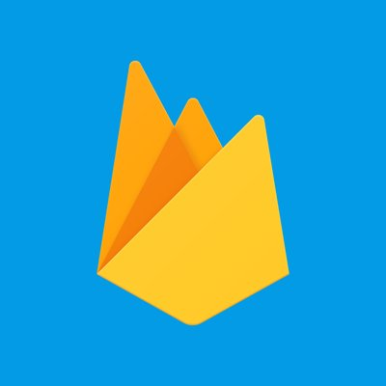
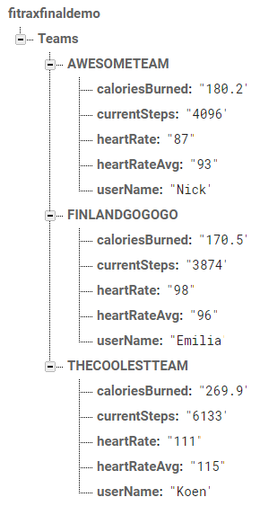
Database
Save user and team data:
User name
Team name
Steps taken
Calories burned
Heart rate (current)
Heart rate (average)
User (solo) saves data
Coach (team) retrieves data

Slide 20
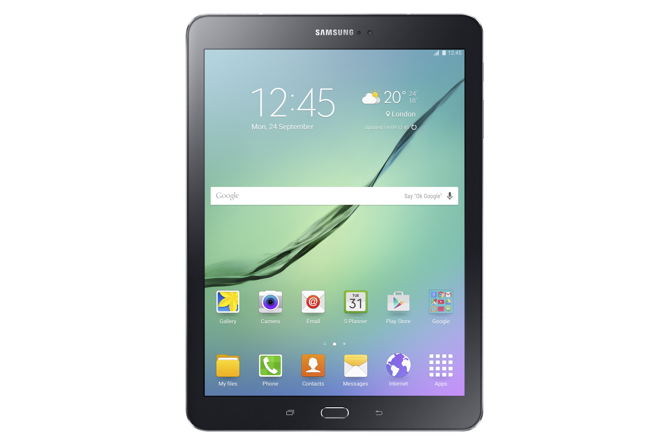
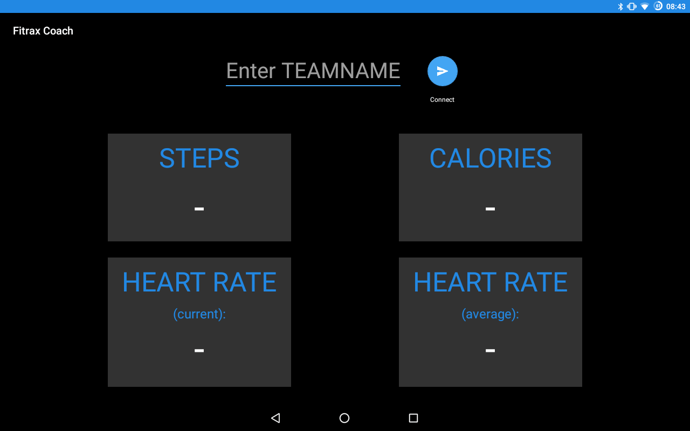
Fitrax coach
Enters TEAMNAME
Pulls data at every update

Slide 21

Demo time!

Slide 22
Questions?

